Slide 1
Types of data and describing data with summary statistics
data science for biologists
stephanie j. spielman, PhD

Slide 2
Types of data
How you analyze and visualize data depends on the type of data you have
Quantitative data
Continuous
Discrete (includes count data)
Categorical data
Nominal
Ordinal
Binary*
Human data type | R data type
Quantitative continuous | Numeric (double)
Quantitative discrete | Numeric (integer)
Categorical nominal | Character or factor
Categorical ordinal | Factor
Categorical binary | Factor or logical

Slide 3
Quantitative data
Continuous
Any real-number value within some range
Discrete
Values are in indivisible units, i.e. whole or counting numbers
Includes count data (number of cups of coffee per day, number of amino acids…)

Slide 4
Categorical data
Nominal
Hair color, eye color, sex genotypes (XX, XY, XXY, XYY, XO, …)
Ordinal – categories with a natural ordering
Bad, fair, good, excellent
A, B, C, D
Binary
Yes/No
True/False

Slide 5
Data types translated
Human data type | R data type
Quantitative continuous | Numeric (double)
Quantitative discrete | Numeric (integer)
Categorical nominal | Character or factor
Categorical ordinal | Factor
Categorical binary | Factor or logical

Slide 6
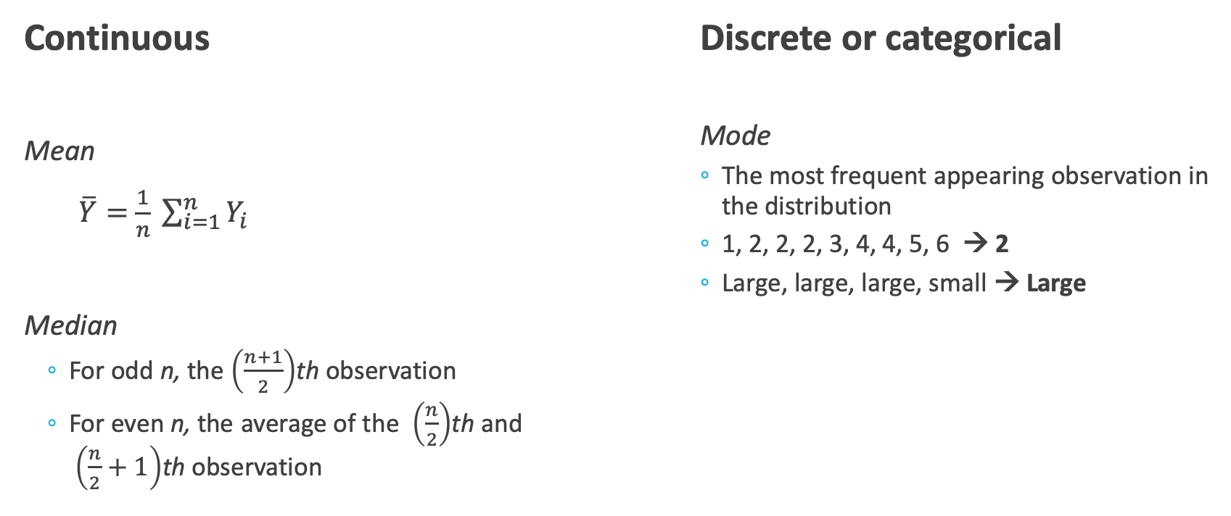
Measures of Location
Continuous
Mean
$\overline{Y}=$ $\frac{1}{n} \sum_{i=1}^{n}{Y_{i}}$
Median
For odd n, the $\left(\frac{n+1}{2}\right)$th observation
For even n, the average of the $\left(\frac{n}{2}\right)$th and $\left(\frac{n}{2}+1\right)$th observation
Discrete or categorical
Mode
The most frequent appearing observation in the distribution
1, 2, 2, 2, 3, 4, 4, 5, 6 → 2
Large, large, large, small → Large

Slide 7
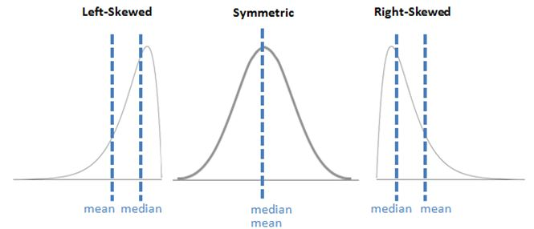
Measures of location in distributions
http://i.imgur.com/YSEYhha.jpg

Slide 8
Measures of spread
Range
Standard deviation and variance
Interquartile range

Slide 9
Range
Difference between largest and smallest value in a distribution
1, 2, 3, 7, 9 → 8
1, 2, 3, 7, 9, 500 → 499
Range is very sensitive to extreme observations and becomes very unwieldy very quickly.

Slide 10
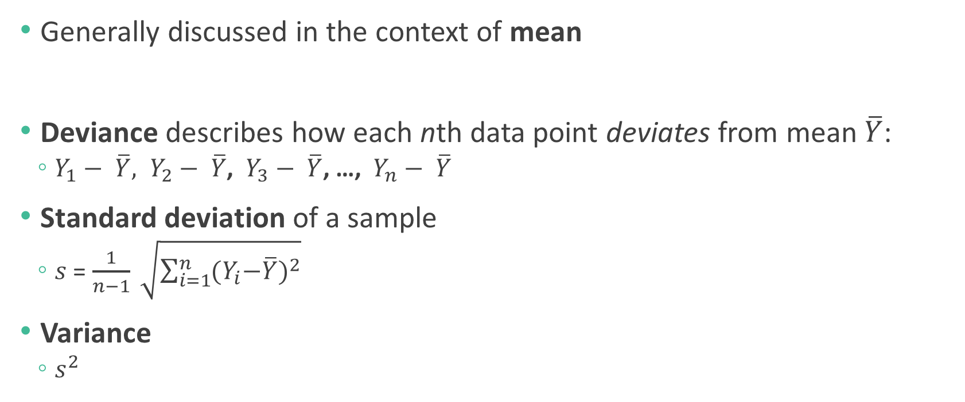
Standard deviation and variance
Generally discussed in the context of mean
Deviance describes how each nth data point deviates from mean $\overline{Y}$:
$Y_{1}− \overline{Y}, Y_{2}− \overline{Y}$, $Y_{3}− \overline{Y}$, …, $Y_{n}− \overline{Y}$
Standard deviation of a sample
$s$ = $\frac{1}{n−1} \sqrt{\sum_{i=1}^{n}{{{(Y}_{i}−\overline{Y})}^{2}}}$
Variance
$s^{2}$

Slide 11
Interquartile range
Generally discussed in the context of median
Quartiles divide the data into four equal parts (“quar”!)
Interquartile range (IQR) is the difference between the third and first quartile
How much of the data does the IQR encompass?
Five number summary: min, Q1, median, Q3, max

Slide 12
Mean or median?
The median is much more robust to outliers compared to the mean.

Slide 13
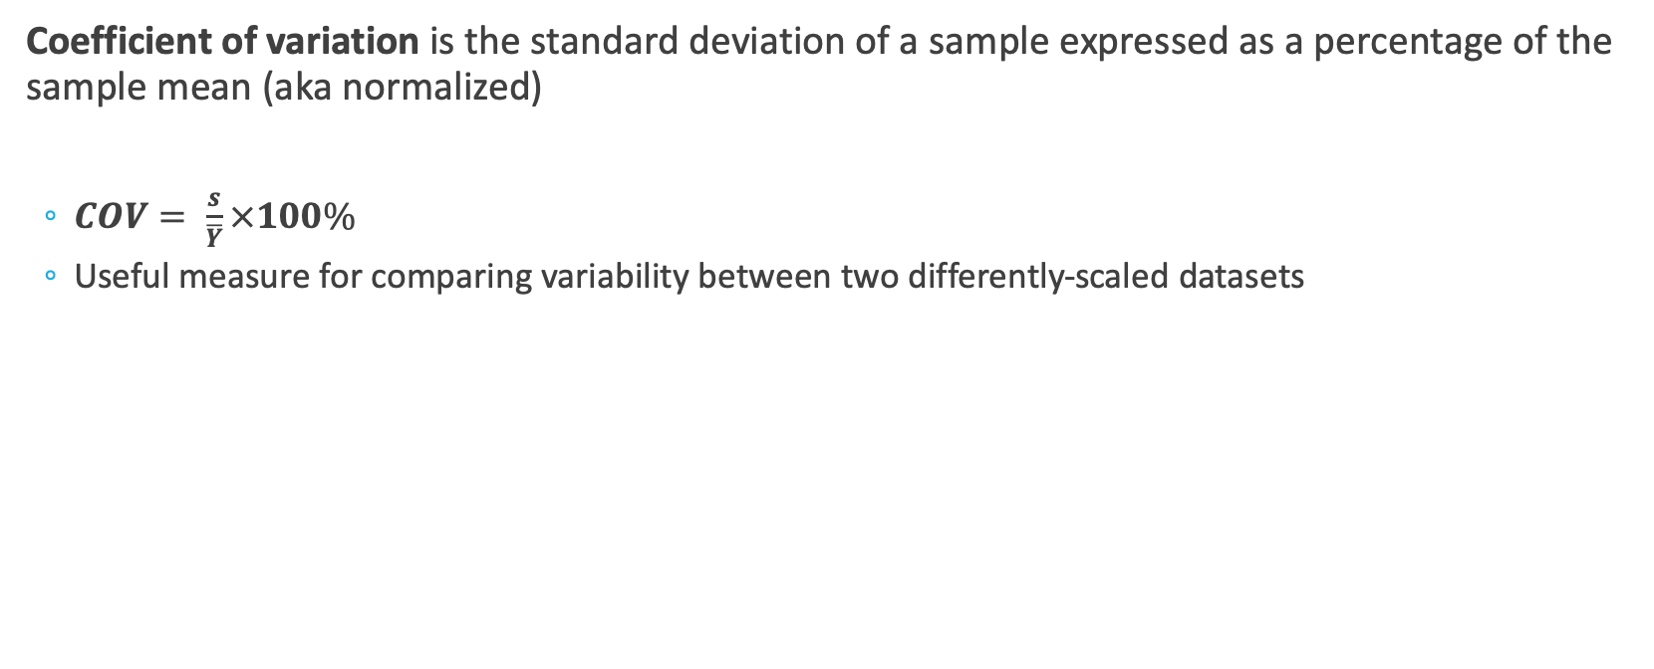
Measures of variability
Coefficient of variation is the standard deviation of a sample expressed as a percentage of the sample mean (aka normalized)
$COV= \frac{s}{\overline{Y}}×100\%$
Useful measure for comparing variability between two differently-scaled datasets

Slide 14
Visualizing data
Different types of plots are used to represent different types of data
Continuous data
Histogram
Density plot
Boxplot
Violin plot
Discrete data
Bar plot
Comparing two continuous variables
Scatterplot
Trend over time
Line plot

Slide 15
“Directory of data visualizations” (ch5)

Slide 16
Histogram

Slide 17
Using histograms to describe distributions

Slide 18
Density plots smoothen histograms

Slide 19
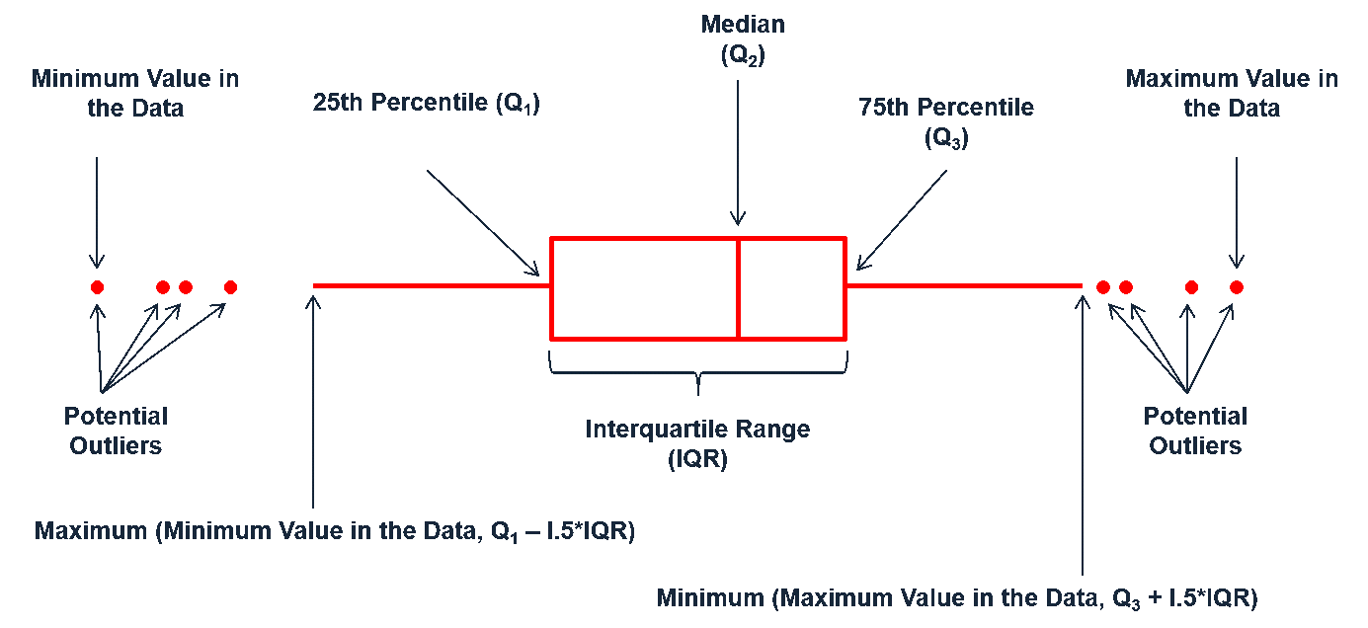
Boxplot
Graphical representation of a five-number summary
“Whiskers” calculated as data within +/- 1.5 IQR
“whiskers”
Q3
Median
IQR
Q1
outliers

Slide 20
Boxplots: The plot thickens*
*Pun intended.
Notes:
So why are there outliers in one and not the other?

Slide 21
Visualizing amounts/proportions
“dodged” = grouped

Slide 22
Barplot

Slide 23
Barplots for quantitative data
The response is the length of odontoblasts (cells responsible for tooth growth) in 60 guinea pigs. Each animal received one of three dose levels of vitamin C (0.5, 1, and 2 mg/day) by one of two delivery methods, orange juice or ascorbic acid (a form of vitamin C and coded as ‘VC’).

Slide 24
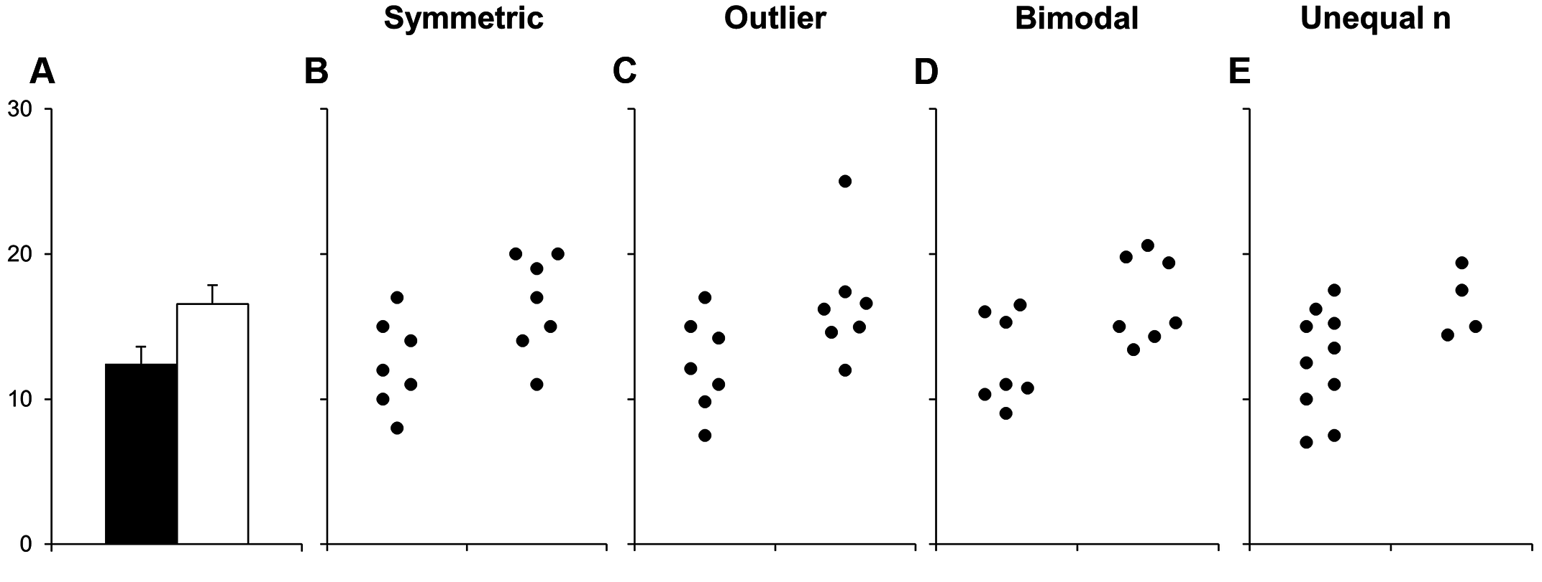
Why you should NEVER USE barplots for quantitative data
http://journals.plos.org/plosbiology/article?id=10.1371/journal.pbio.1002128

Slide 25
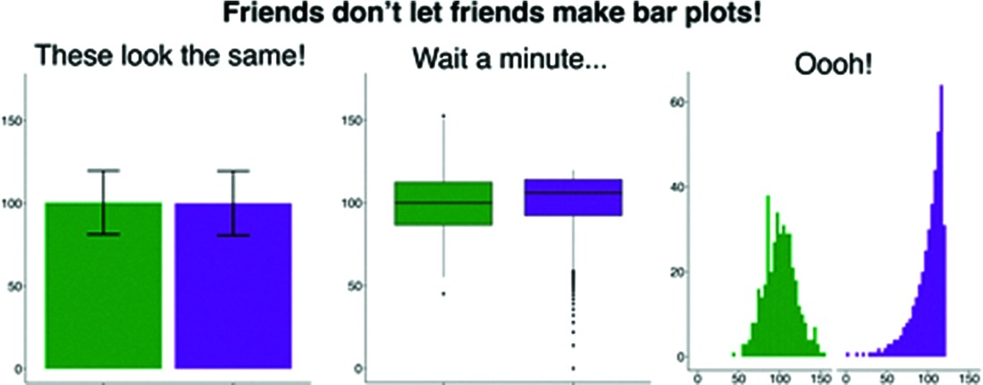
It’s just an awful way to visualize DATA
https://onlinelibrary.wiley.com/doi/full/10.1111/modl.12386

Slide 26
Scatterplot
response/dependent variable
explanatory/independent variable

Slide 27
Time series data

